Slide 1
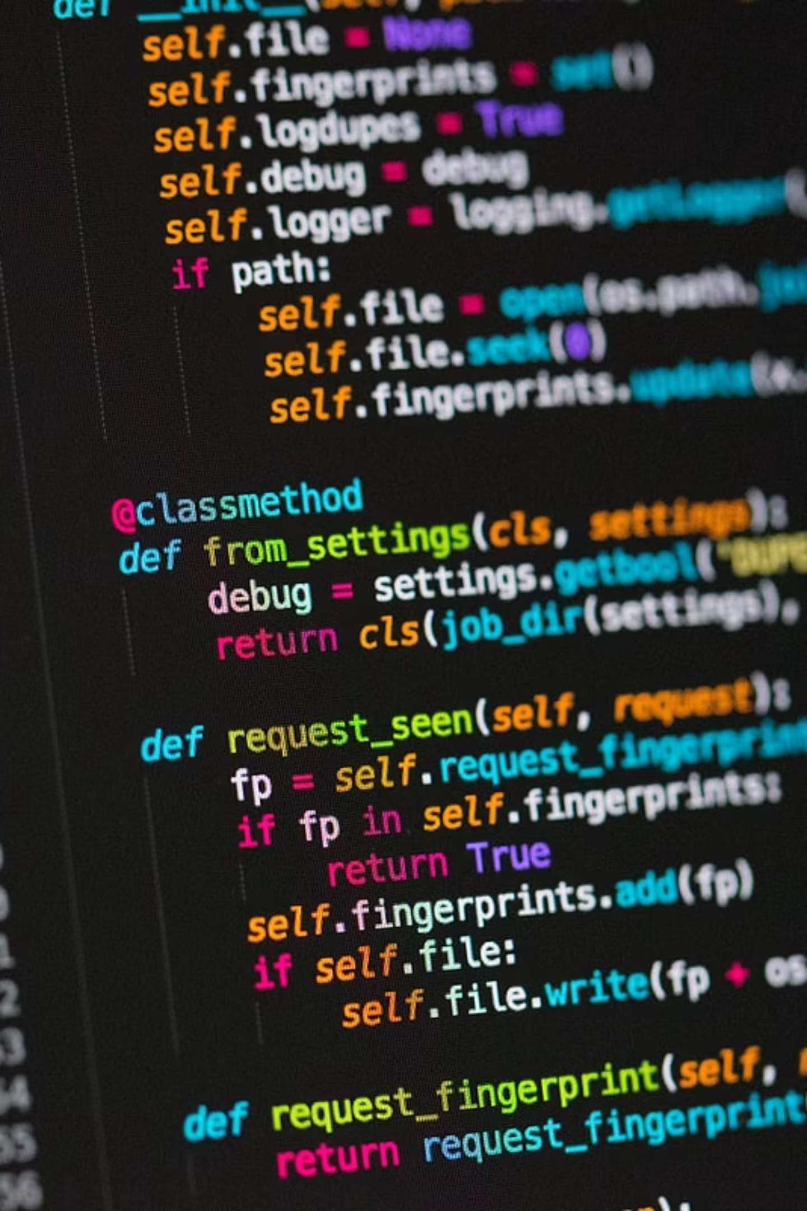
Python for Data Science
Loops, Functions, Modules, and Packages

Slide 2
What Are Loops and Why Do We Need Them?
A loop helps us:
Repeat tasks efficiently
Reduce code duplication
Work with large amounts of data
Automate processes
Build scalable programs
A loop is a programming structure that executes a set of instructions repeatedly until a condition is met.
Instead of writing repetitive code manually, loops automate repetition.
Real-World Examples
The Repetition Problem
Scrolling through your Instagram feed
Processing each item in a shopping cart
Checking every student's grade in a list
Reading through all emails in your inbox
Imagine you need to greet 100 students in a class. Writing print("Hello!") 100 times would be exhausting! Loops solve this by automating repetition.

Slide 3

The for Loop: Your First Automation Tool
01
02
03
Understanding the Syntax
Common Sequences
Indentation Matters
for item in sequence: means "do something with each item in this collection"
Lists, strings, tuples — any collection of items you want to process one by one
Python uses spacing to know which code belongs inside the loop — always indent by 4 spaces
Common Beginner Mistake
Forgetting the colon : at the end of the first line or mixing up indentation levels

Slide 4
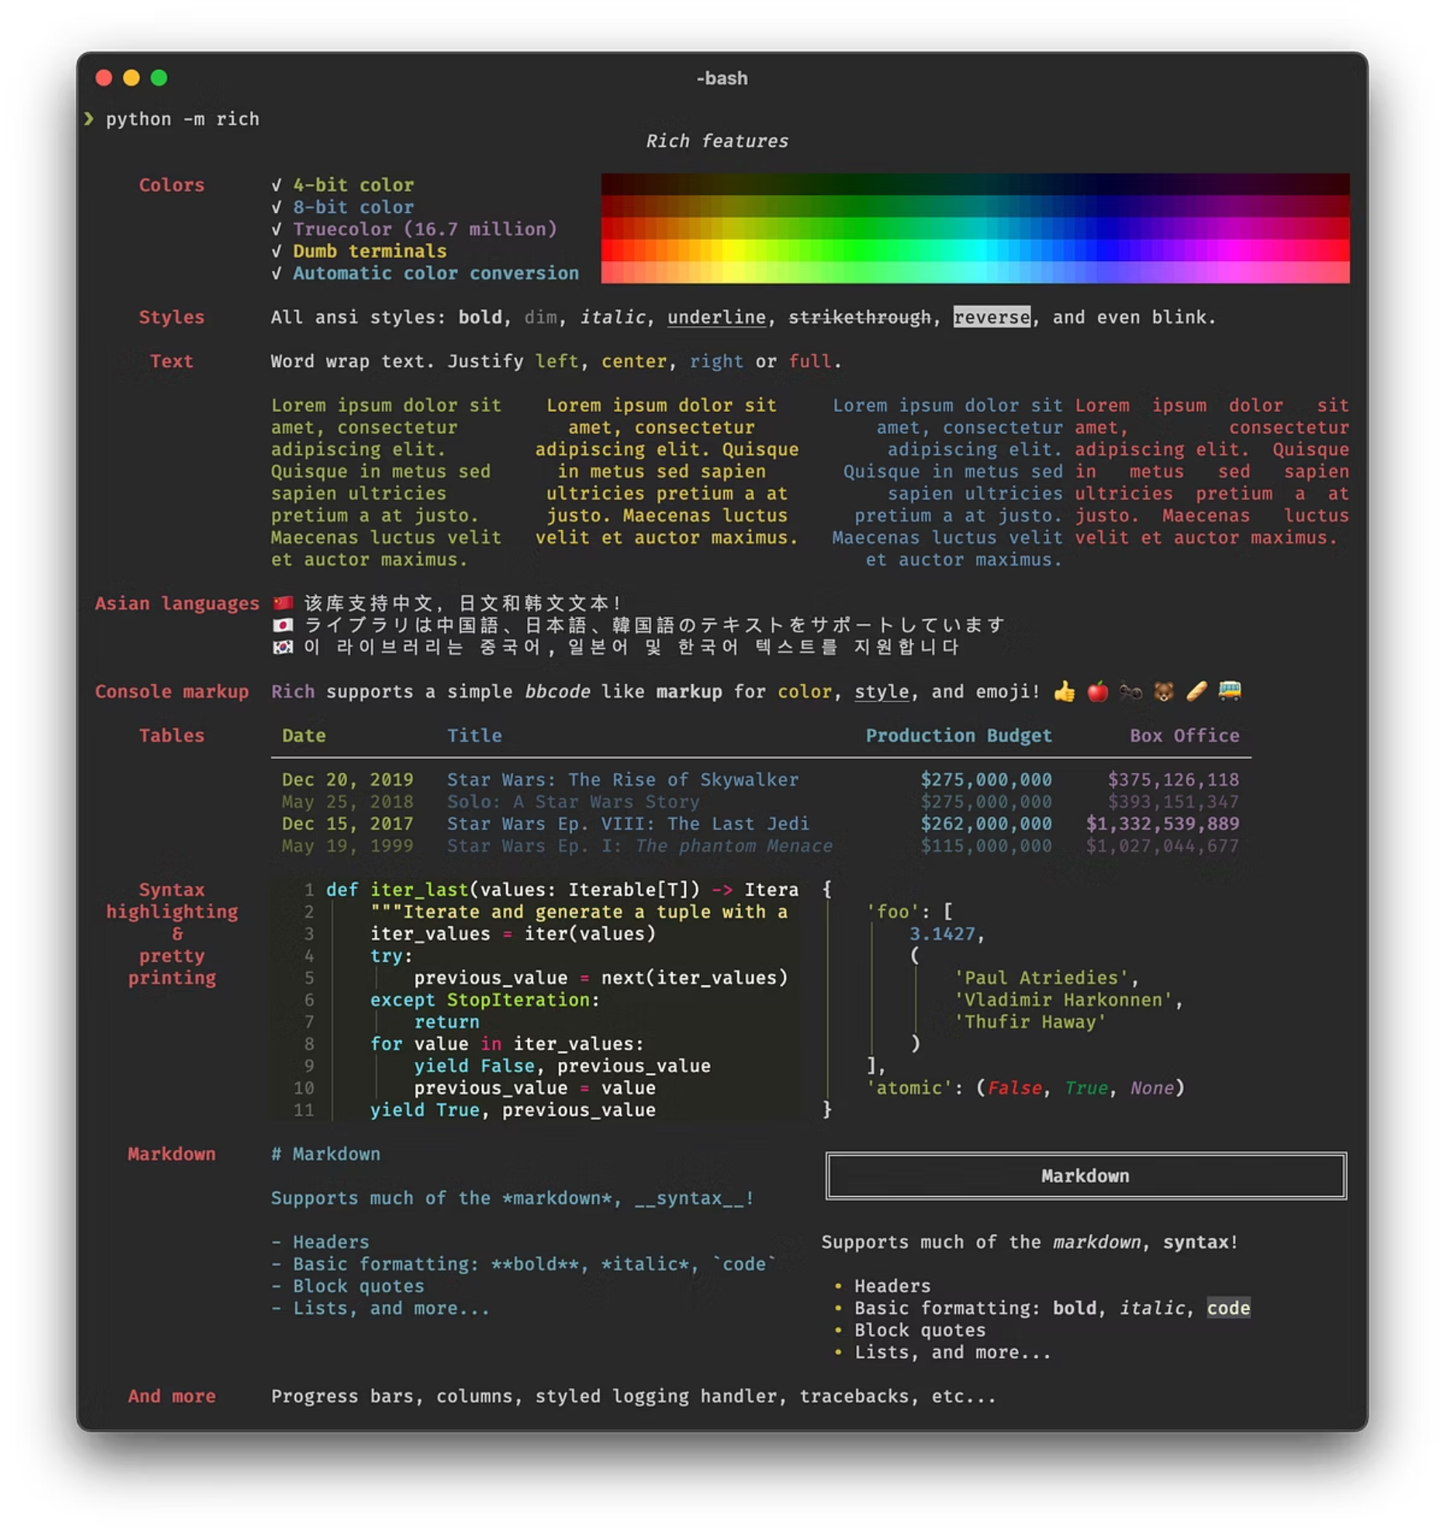
for Loop in Action
Example 1: Greeting Students
Example 2: Processing Letters
message = "Python"
for letter in message:
print(letter.upper())
students = ["Alice", "Bob", "Charlie"]
for student in students:
print(f"Hello, {student}!")
Output:
P
Y
T
H
O
N
Output:
Hello, Alice!
Hello, Bob!
Hello, Charlie!

Slide 5

The range() Function: Creating Number Sequences
range(stop)
range(start, stop)
range(start, stop, step)
Numbers from 0 to stop-1
Numbers from start to stop-1
Numbers with custom intervals
range(5)
# 0, 1, 2, 3, 4
range(2, 6)
# 2, 3, 4, 5
range(1, 10, 2)
# 1, 3, 5, 7, 9
Remember: range() doesn't include the stop value — it goes up to but not including it!

Slide 6
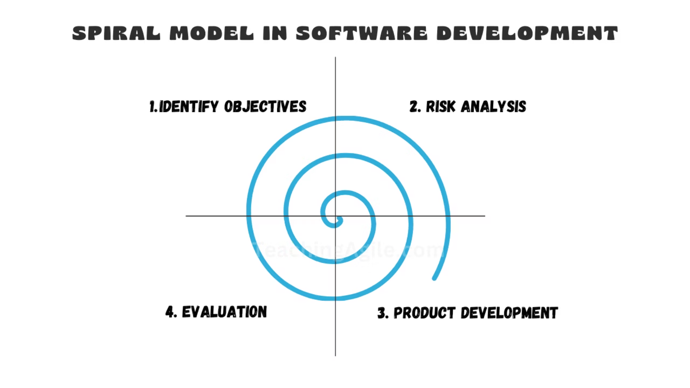
while Loop: Looping with Conditions
When to Use while
Use while when you don't know exactly how many times to loop — it continues as long as a condition is True.
Watch Out for Infinite Loops!
Always ensure your condition will eventually become False, or your program will run forever.
Basic Syntax
Counter Example
while condition:
# code block
# update condition
count = 0
while count < 3:
print(count)
count += 1
# 0, 1, 2

Slide 7
Loop Control Statements
break
Exits the loop immediately, regardless of the condition. Like finding what you're looking for and stopping the search.
continue
Skips the current iteration and moves to the next one. Like skipping over items that don't meet your criteria.
pass
Does nothing — a placeholder when syntax requires code but you're not ready to write it yet.

Slide 8


Nested Loops: Loops Inside Loops
The Concept
Example Output
Think of a grid: the outer loop handles rows, the inner loop handles columns. For each row, all columns are processed.
Row 0, Col 0
Row 0, Col 1
Row 1, Col 0
Row 1, Col 1
Row 2, Col 0
Row 2, Col 1
Visual Pattern
for i in range(3):
for j in range(2):
print(f"Row {i}, Col {j}")
Performance Note
Nested loops can be slow with large datasets. Use them carefully and consider if there's a more efficient approach!

Slide 9



Loop with else Clause
Normal Loop Completion
Loop with break
If the loop finishes naturally (without break), the else block runs
If break is triggered, the else block is skipped
Example: Finding a Number
numbers = [1, 2, 3, 4, 5]
target = 6
for num in numbers:
if num == target:
print(f"Found {target}!")
break
else:
print(f"{target} not found in list")
Output: 6 not found in list

Slide 10

Functions: Reusable Code Blocks
Why Functions?
def Keyword
Write code once, use it many times. Keep your programs organized and avoid repeating yourself.
Start every function with def function_name(): followed by indented code
Calling Functions
Use function_name() to execute the code inside the function
Simple Function Example
def greet():
print("Hello, welcome to Python!")
greet() # Call the function
# Output: Hello, welcome to Python!

Slide 11
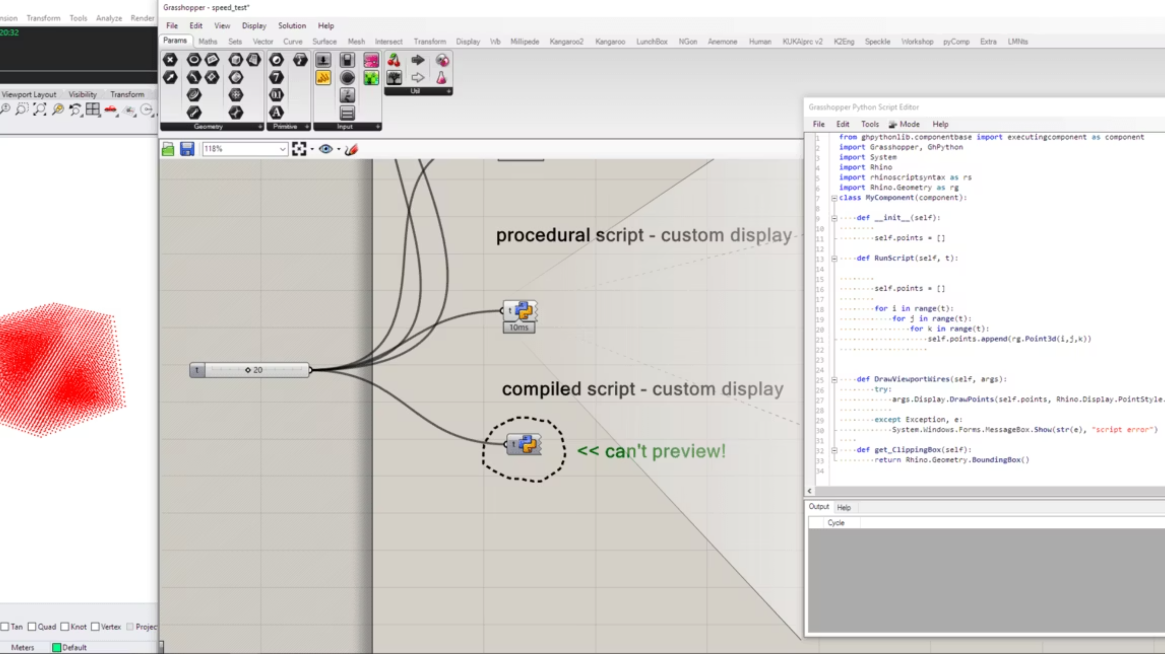


Functions: Parameters and Arguments
To make functions flexible and perform different actions based on input, we use parameters and arguments.
Parameters: The Blueprint
Arguments: The Actual Values
Variables listed inside the parentheses in the function's definition. They act as placeholders for values the function needs to operate.
The actual values passed to the function when it is called. These values are assigned to the corresponding parameters.
Positional Arguments
The simplest way to pass arguments is by their position. Python matches arguments to parameters in the order they are provided.
Example: Greeting with a Name
Output & Explanation
def greet(name, time_of_day):
print(f"Good {time_of_day}, {name}!")
greet("Alice", "morning")
greet("Bob", "evening")
Good morning, Alice!
Good evening, Bob!
Here, "Alice" and "Bob" are positional arguments for the name parameter, and "morning" and "evening" for time_of_day.
Analogy: A Recipe
Think of a recipe as a function. The ingredients list (like "sugar", "flour") are its parameters. When you actually bake a cake, the specific amounts you add (e.g., "1 cup of sugar", "2 cups of flour") are the arguments.

Slide 12
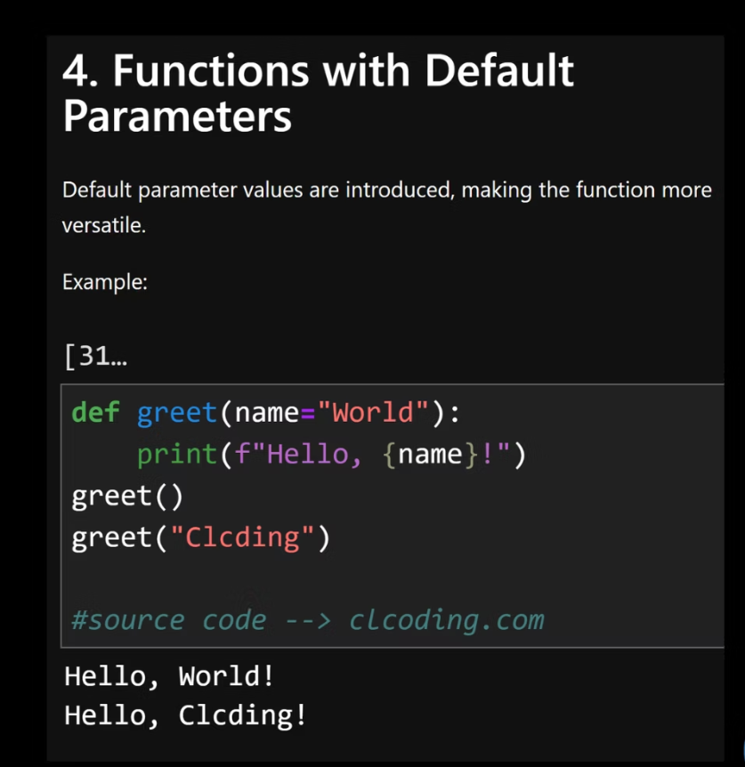

Default Arguments
Default arguments allow you to assign a default value to a function parameter. If the caller doesn't provide a value for that parameter, the default value is used. This makes functions more flexible and prevents errors when certain arguments are optional.
Why They Are Useful
Flexibility: Call the function with fewer arguments for common use cases.
Readability: Clearly indicates optional parameters and their standard values.
Maintainability: Avoids needing to write multiple functions for slightly different behaviors.
Example: Customizable Greeting
def greet(name, message="Hello"):
print(f"{message}, {name}!")
greet("Alice") # Uses default message
greet("Bob", "Hi") # Overrides default message
greet(message="Good morning", name="Charlie") # Keyword args also work
Output:
Hello, Alice!
Hi, Bob!
Good morning, Charlie!

Slide 13
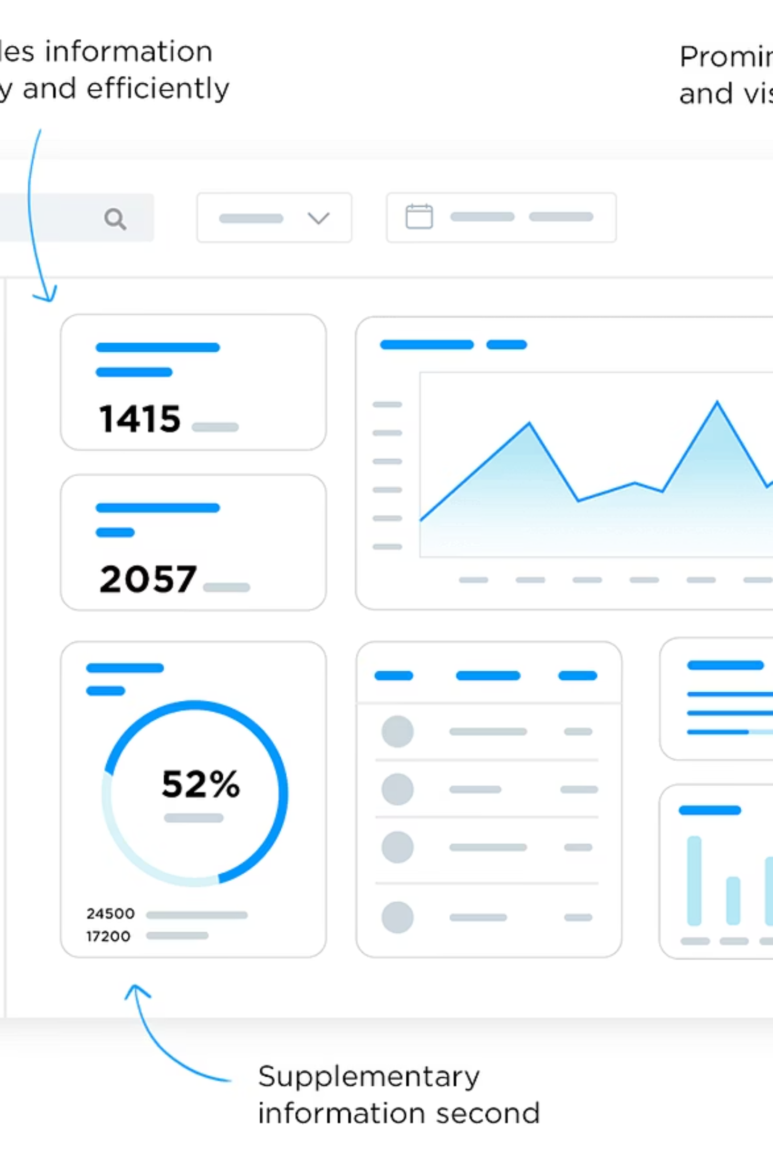

Keyword Arguments
Keyword arguments allow you to pass values to a function by explicitly naming the parameter they correspond to, rather than relying solely on their position.
Enhanced Readability
Order Independence
Function calls become self-documenting, making the code easier to understand at a glance, especially for functions with many parameters.
You can provide arguments in any order, as long as you specify the parameter name, which increases flexibility.
Preventing Errors
Reduces the chance of passing values to the wrong parameters, especially when some parameters have default values.
Example: Customizing a Report
Output:
def create_report(title, author="Anonymous", format="PDF"):
print(f"Generating Report:")
print(f"Title: {title}")
print(f"Author: {author}")
print(f"Format: {format}")
# Using keyword arguments
create_report(title="Quarterly Review", format="DOCX", author="Dr. Smith")
print("\n---")
create_report(format="TXT", title="Daily Log") # Order doesn't matter
Generating Report:
Title: Quarterly Review
Author: Dr. Smith
Format: DOCX
---
Generating Report:
Title: Daily Log
Author: Anonymous
Format: TXT
Notice how the order of format and title doesn't matter in the second call, and the default author is used because it wasn't specified.

Slide 14

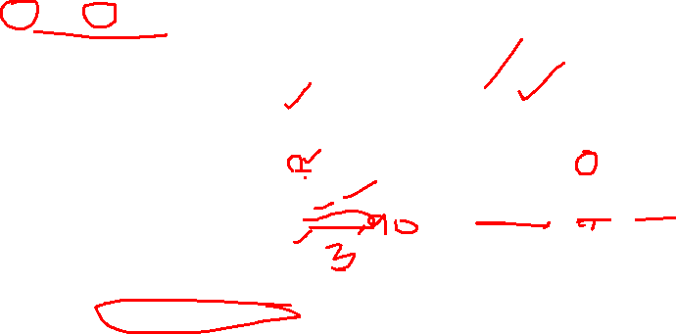
*args and **kwargs: Flexible Function Inputs
Python provides special syntax to allow functions to accept a variable number of positional arguments (`*args`) and keyword arguments (`**kwargs`). This makes your functions incredibly flexible and reusable.
1
2
*args (Arbitrary Positional Arguments)
**kwargs (Arbitrary Keyword Arguments)
The single asterisk `*` gathers all extra positional arguments into a tuple. You can then iterate over this tuple inside your function.
The double asterisk `**` collects all extra keyword arguments into a dictionary. This allows functions to accept an undefined number of named parameters.
def sum_all(*numbers):
total = 0
for num in numbers:
total += num
return total
print(sum_all(1, 2, 3, 4))
# Output: 10
def build_profile(**details):
for key, value in details.items():
print(f"{key.replace('_', ' ').title()}: {value}")
build_profile(name="Alice", age=30, city="NY")
# Output:
# Name: Alice
# Age: 30
# City: NY
Combining *args and **kwargs
Analogy: Ordering at a Restaurant 🍽️
You can use both in the same function definition. `*args` must come before `**kwargs`.
Imagine ordering food:
def configure_system(main_setting, *options, **settings):
print(f"Main Setting: {main_setting}")
if options:
print(f"Options: {options}") # Tuple
if settings:
print(f"Custom Settings: {settings}") # Dictionary
configure_system(
"startup",
"verbose", "debug_mode", # *options
log_level="INFO",
max_retries=5 # **settings
)
Output:
Main Setting: startup
Options: ('verbose', 'debug_mode')
Custom Settings: {'log_level': 'INFO', 'max_retries': 5}
`*args`: You tell the waiter your main dishes: "I'll have the pizza, pasta, and salad." (A list of items, in order).
`**kwargs`: You then add special requests or modifications: "And for the pizza, I want extra_cheese='yes' and no_olives='true'." (Named, optional additions).
This demonstrates how `*args` captures the two string options as a tuple, and `**kwargs` captures the `log_level` and `max_retries` as a dictionary of key-value pairs.

Slide 15
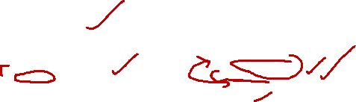
Return Statements
The return statement is how a Python function sends a value or result back to the part of the code that called it. This is fundamental for building functions that perform computations and pass their outcomes for further processing.
print(): For Displaying
return: For Providing a Value
Displays output to the console for human viewing. It does not pass any value back to the caller. Its primary purpose is side effects (showing information).
Sends a value back to the caller and immediately exits the function. This value can be stored in a variable or used in expressions. Its primary purpose is computation and data transfer.
def show_message(msg):
print(msg) # Displays "Hello"
show_message("Hello")
result = show_message("Hello")
print(result) # Output: None
def get_message(msg):
return msg # Returns "Hello"
message = get_message("Hello")
print(message) # Output: Hello
Function Output Flow
When Python encounters a return statement, the function execution stops, and the specified value is immediately sent back to the calling context. Any code after return in the function will not execute.
def calculate_area(length, width):
area = length * width
return area # Sends 'area' back
def get_status(score):
if score >= 60:
return "Pass"
else:
return "Fail"
print("This won't run!") # Unreachable
# Using the returned values
room_area = calculate_area(5, 10)
print(f"Room area: {room_area} sq. units")
student_result = get_status(75)
print(f"Student status: {student_result}")
another_student_result = get_status(45)
print(f"Another student status: {another_student_result}")
Explanation & Output:
The calculate_area function computes the area and then explicitly returns that numerical value. This value is then stored in the room_area variable for later use.
The get_status function returns a string based on a condition. Notice how the print("This won't run!") line is never executed because return immediately exits the function.
Room area: 50 sq. units
Student status: Pass
Another student status: Fail

Slide 16
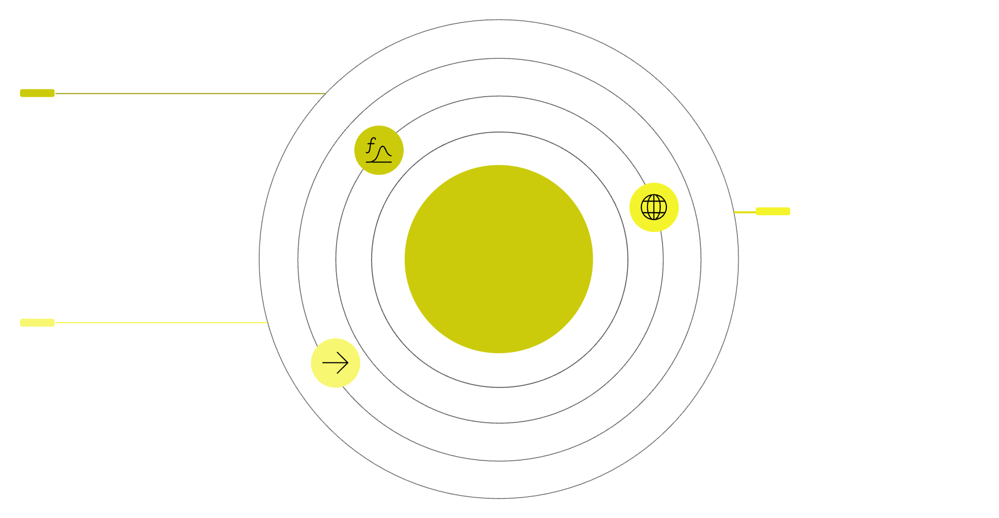


Variable Scope: Local vs. Global
In Python, variable scope defines where a variable can be accessed, created, or modified within your program. Understanding scope prevents unexpected errors and makes your code more predictable.
Local Variables
Global Variables
Variables defined inside a function are local to that function. They can only be accessed from within that function's block. Once the function completes, these variables are destroyed.
Variables defined outside of any function (at the top level of a script or module) are global. They can be accessed from anywhere in the program, including inside functions. To modify a global variable inside a function, you need to explicitly declare it using the global keyword.
def greet():
message = "Hello from local" # Local variable
print(message)
greet()
# print(message) # This would cause an error (NameError)
greeting = "Hello from global" # Global variable
def show_greeting():
print(greeting) # Access global variable
def change_greeting():
global greeting # Declare intent to modify global
greeting = "Updated global greeting"
show_greeting()
change_greeting()
show_greeting()
Visualizing Variable Scope
Function Scope
message exists only inside the function
Python Variable Scope
Global Scope
greeting is accessible throughout the program
Accessibility
Arrows: function → global and global → function access
This diagram shows how global variables exist at the top level of your program and are generally accessible everywhere, while local variables are confined to the specific function where they are defined, created when the function is called, and destroyed when it exits.
Common Mistakes
Attempting to access a local variable outside its function scope.
Forgetting to use the global keyword when trying to modify a global variable inside a function, which often leads to Python creating a new local variable with the same name instead.

Slide 17



Lambda Functions
Lambda functions are small, anonymous functions defined using the lambda keyword. Unlike traditional functions (def), they don't have a name and are restricted to a single expression. They are primarily used for quick, inline operations where a full function definition would be verbose.
Syntax & Use Cases
Lambda functions shine in situations requiring a small function for a short period, especially as arguments to higher-order functions like map(), filter(), or sort()'s key parameter. They offer a concise alternative to defining a full function with def.
# Syntax: lambda arguments: expression
# Example 1: Adding two numbers
add = lambda a, b: a + b
print(add(3, 5)) # Output: 8
# Example 2: Squaring a number
square = lambda x: x * x
print(square(7)) # Output: 49
Key Difference
def creates a named function with multiple statements; lambda creates an anonymous function with a single expression.

Slide 18

Higher-Order Functions: `map()`, `filter()`, `zip()`
Python offers powerful built-in higher-order functions like map(), filter(), and zip() that simplify data manipulation by processing iterables efficiently. These functions are cornerstones in data science for transforming, selecting, and combining datasets without explicit loops, leading to more concise and readable code.
map(): Apply a Function
filter(): Select Elements
zip(): Combine Iterables
Applies a given function to each item of an iterable (like a list) and returns a map object, which is an iterator. In data science, this is invaluable for feature engineering (e.g., scaling numerical features) or data cleaning (e.g., converting data types across an entire column).
Constructs an iterator from elements of an iterable for which a function returns true. This is perfect for selecting specific rows based on criteria or cleaning outliers from datasets. It helps in focusing on relevant data subsets for analysis.
Combines elements from multiple iterables into tuples, pairing corresponding items. It stops when the shortest iterable is exhausted. This is extremely useful for creating temporary associations between different data arrays, like pairing features with labels, or combining two columns into key-value pairs.
# Double each number in a list
numbers = [1, 2, 3, 4]
doubled = list(map(lambda x: x * 2, numbers))
# Output: [2, 4, 6, 8]
# Keep only even numbers
numbers = [1, 2, 3, 4, 5, 6]
evens = list(filter(lambda x: x % 2 == 0, numbers))
# Output: [2, 4, 6]
# Combine names and scores
names = ["Alice", "Bob"]
scores = [90, 85]
paired_data = list(zip(names, scores))
# Output: [('Alice', 90), ('Bob', 85)]
Visually, map() takes a stream of input values, passes each one through a processing unit (the function), and generates a new stream of transformed output values. It's a one-to-one transformation for every element.
Imagine filter() as a sieve or a funnel: it lets some elements pass through based on a condition and discards others. It's a selective process that reduces the volume of data based on defined rules.
zip() works like a zipper, taking elements from parallel sequences and merging them together, element by element, into a single new sequence of pairs or tuples. It synchronizes multiple lists into a unified structure.

Slide 19

Modules in Python: Building Blocks for Robust Code
As your Python projects grow, keeping all your code in a single file becomes unmanageable. Python modules provide an elegant solution by allowing you to organize related code into separate files. Think of modules as toolboxes, each containing a specific set of tools (functions, classes, variables) that you can use across different parts of your application.
What Are Modules?
Why Are Modules Useful?
A module is simply a Python file (.py) containing Python definitions and statements. Any Python file can be a module. For instance, if you have a file named my_math.py, it can serve as a module.
Reusability: Use code written once in many programs.
Organization: Group related code, making your project easier to understand and navigate.
Namespace Isolation: Prevent naming conflicts between different parts of your code.
Collaboration: Multiple developers can work on different modules simultaneously.
The Essence of Code Organization
Modules are fundamental to structuring larger Python applications, from simple scripts to complex data science pipelines. They enable a modular programming approach, breaking down complex problems into smaller, manageable, and interconnected components.

Slide 20

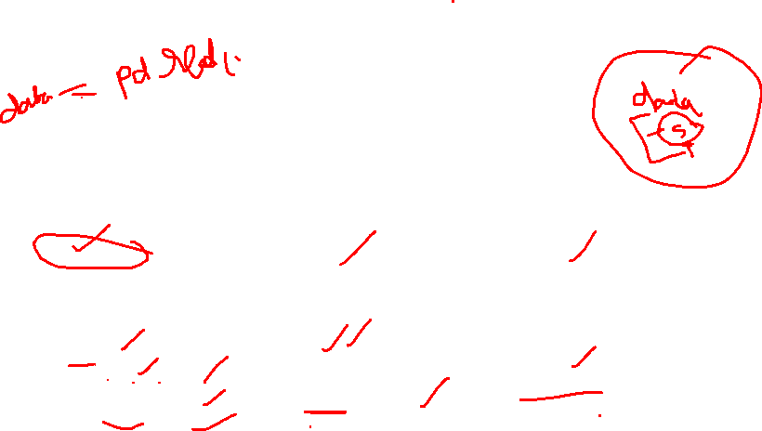
Built-in Modules: Expanding Python's Capabilities
Python's strength lies not only in its core language but also in its extensive collection of built-in modules. These pre-written code libraries offer ready-to-use functionalities, saving development time and effort. Let's explore some fundamental ones.
math Module
os Module
sys Module
Provides access to mathematical functions for both real and complex numbers. Essential for scientific and data computations.
Offers a way to interact with the operating system, enabling file and directory operations like navigating paths or listing contents.
Provides access to system-specific parameters and functions, useful for command-line arguments and interacting with the interpreter.
import math
print(math.sqrt(25)) # 5.0
print(math.ceil(4.2)) # 5
print(math.floor(4.9)) # 4
print(math.pi) # 3.14159...
import os
print(os.getcwd()) # Current directory
# os.mkdir("new_folder")
# os.remove("file.txt")
import sys
# print(sys.argv) # Cmd line args
print(sys.version) # Python version
# sys.exit()

Slide 21
The random Module: Embracing Chance in Data
The random module in Python is a fundamental tool for generating pseudorandom numbers and sequences. It's essential in data science for tasks ranging from simulating experiments and creating random samples to shuffling datasets for unbiased model training. Understanding its functions allows you to introduce controlled randomness into your analyses.
random(): Float [0.0, 1.0)
randint(a, b): Integer Range
choice(seq): Random Element
Generates a random floating-point number between 0.0 (inclusive) and 1.0 (exclusive). Ideal for probability simulations and normalized random values.
Returns a random integer N such that a <= N <= b. Perfect for selecting elements by index or simulating discrete events.
Returns a random element from a non-empty sequence (e.g., list, tuple, string). Useful for random sampling or decision-making processes.
import random
print(random.randint(1, 10)) # e.g., 5
import random
data = ["A", "B", "C"]
print(random.choice(data)) # e.g., "B"
import random
print(random.random()) # e.g., 0.835
shuffle(list): In-place Shuffle
Randomly shuffles the elements of a sequence in place, meaning it modifies the original list. Crucial for randomizing datasets before training machine learning models.
import random
cards = [1, 2, 3, 4]
random.shuffle(cards)
print(cards) # e.g., [3, 1, 4, 2]
Real-world Examples
The random module's versatility makes it indispensable in various data science applications:
Games and Simulations: Generating dice rolls, card draws, or random events in complex system simulations.
Statistical Sampling: Creating random subsets of large datasets for faster analysis or cross-validation in machine learning.
Security and Cryptography: Though Python's secrets module is preferred for cryptographically secure randomness, random can be used for less sensitive applications like generating temporary tokens.

Slide 22

The datetime Module: Mastering Time in Data Science
Handling dates and times is a common yet critical task in data analysis, machine learning, and reporting. Python's built-in datetime module provides classes to manage dates, times, and time intervals with precision and flexibility. It's indispensable for timestamping events, calculating durations, and performing time-series analysis.
date Object
time Object
Represents a calendar date (year, month, day). Ideal for managing dates without time components.
Represents a local time of day (hour, minute, second, microsecond).
Useful when only the time is needed.
from datetime import date
today = date.today()
print(f"Today's date: {today}")
# Output: Today's date: 2023-10-27 (example)
from datetime import time
lunch_time = time(12, 30, 0)
print(f"Lunch: {lunch_time}")
# Output: Lunch: 12:30:00
datetime Object
timedelta Object
Combines both date and time into a single object. This is the most frequently used class for complete timestamp information.
Represents a duration, the difference between two date, time, or datetime instances.
Essential for calculations involving time intervals.
from datetime import datetime
now = datetime.now()
print(f"Current datetime: {now}")
# Output: Current datetime: 2023-10-27 10:45:00.123456 (example)
from datetime import datetime, timedelta
future_date = datetime.now() + timedelta(days=7, hours=3)
print(f"In 1 week and 3 hours: {future_date}")
# Output: In 1 week and 3 hours: 2023-11-03 13:45:00.123456 (example)
The datetime module simplifies complex time operations, allowing data professionals to clean, transform, and analyze time-based data effectively.

Slide 23
pip – Python Package Manager
pip is the essential tool for working with Python's rich ecosystem of external libraries. It simplifies the process of installing, managing, and updating software packages, enabling data scientists to leverage powerful tools developed by the community.
What is pip?
Python's standard package-management system. It enables installation and management of software packages from the Python Package Index (PyPI).
Why Packages Are Needed
Packages extend Python's capabilities, providing pre-written, tested code for specific tasks, saving development time and effort.
Installing Libraries
Easily install external libraries using pip install package_name in your terminal. pip handles dependencies automatically.
Third-Party Packages
These are community-developed libraries, not built into Python. They offer specialized tools for data science, web development, and more.
Importance in Data Science
pip is crucial for data science, allowing access to libraries like NumPy, Pandas, Scikit-learn, and Matplotlib for efficient data manipulation, analysis, and visualization.

Slide 24
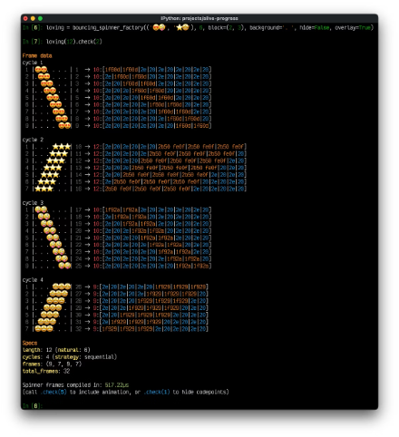

Installing Packages with pip
Mastering package installation is crucial for Python developers, especially in data science, where numerous specialized libraries are used. pip streamlines this process, allowing you to easily extend Python's capabilities.
The pip install Command
Installing Key Data Science Libraries
Verifying Installation
This is the primary command to fetch and install packages from PyPI (Python Package Index). It handles dependencies automatically.
You can install multiple packages at once by listing them. For example, to get numpy, pandas, and matplotlib:
After installation, you can confirm a package is available by attempting to import it in a Python interpreter or using pip show.
pip install package_name
pip install numpy pandas matplotlib
python -c "import numpy; print(numpy.__version__)"
Common Installation Errors
Best Practices
Watch out for permission issues (use --user or virtual environments), network problems, or missing build tools (e.g., C++ compilers for some packages).
Always use virtual environments (venv) to isolate project dependencies. Manage project requirements with a requirements.txt file (pip freeze > requirements.txt).

Slide 25
Quick Summary:
Control Flow & Iteration
Functions & Reusability
for and while loops for automating repetitive tasks and processing data sequences, along with control statements like break and continue for precise execution management.
Explored how to define and use functions, including parameters, arguments, *args, **kwargs, and return statements. We also touched upon variable scope, lambda functions, and higher-order functions like map() for advanced programming.
Modules & Ecosystem
Package Management with pip
Understood the importance of modules for organizing code and extending Python's capabilities. We specifically examined the random module for generating randomness and datetime for handling time-series data.
Learned how pip simplifies installing, updating, and managing third-party libraries from PyPI, enabling access to powerful data science tools like NumPy, Pandas, and Matplotlib.

Slide 26
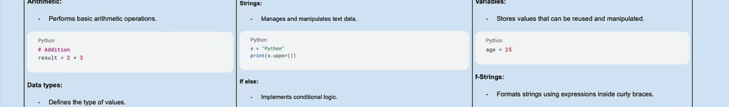
Cheat Sheet
Quickly reference essential Python concepts for your data science journey.
Control Flow
Functions
Modules
Master for and while loops for iteration. Use break and continue for precise flow management.
Define reusable blocks of code. Leverage *args and **kwargs for flexible input. Use lambda for anonymous functions.
Import modules (e.g., random, datetime) to extend Python's functionality with specialized tools.
Package Management
Use pip install [package_name] to add external libraries. Always work within virtual environments.

Slide 27
Cheat Sheet
# LOOPS
for item in list: # Loop through each item
for i in range(10): # Loop 10 times (0-9)
while condition: # Loop until condition False
break # Exit loop immediately
continue # Skip to next iteration
# FUNCTIONS
def name(params): # Define function
return value # Send value back
lambda x: x*2 # One-line function
# HIGHER-ORDER FUNCTIONS
map(func, data) # Apply func to each item
filter(func, data) # Keep items where func True
zip(list1, list2) # Pair items together
# MODULES
import math # Import whole module
from random import randint # Import specific function
pip install package_name # Install external package

